Slide 1
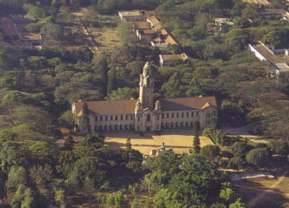
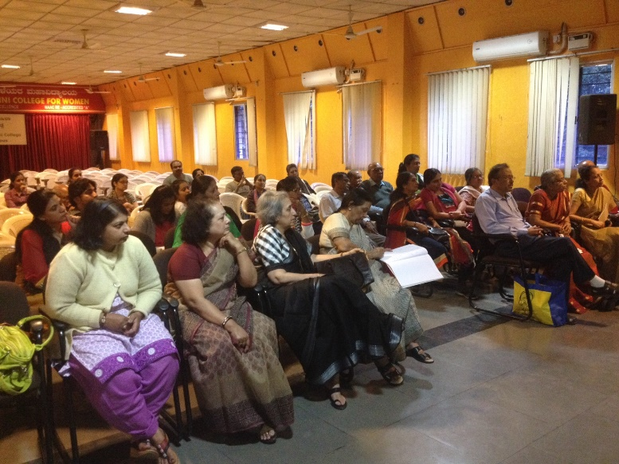
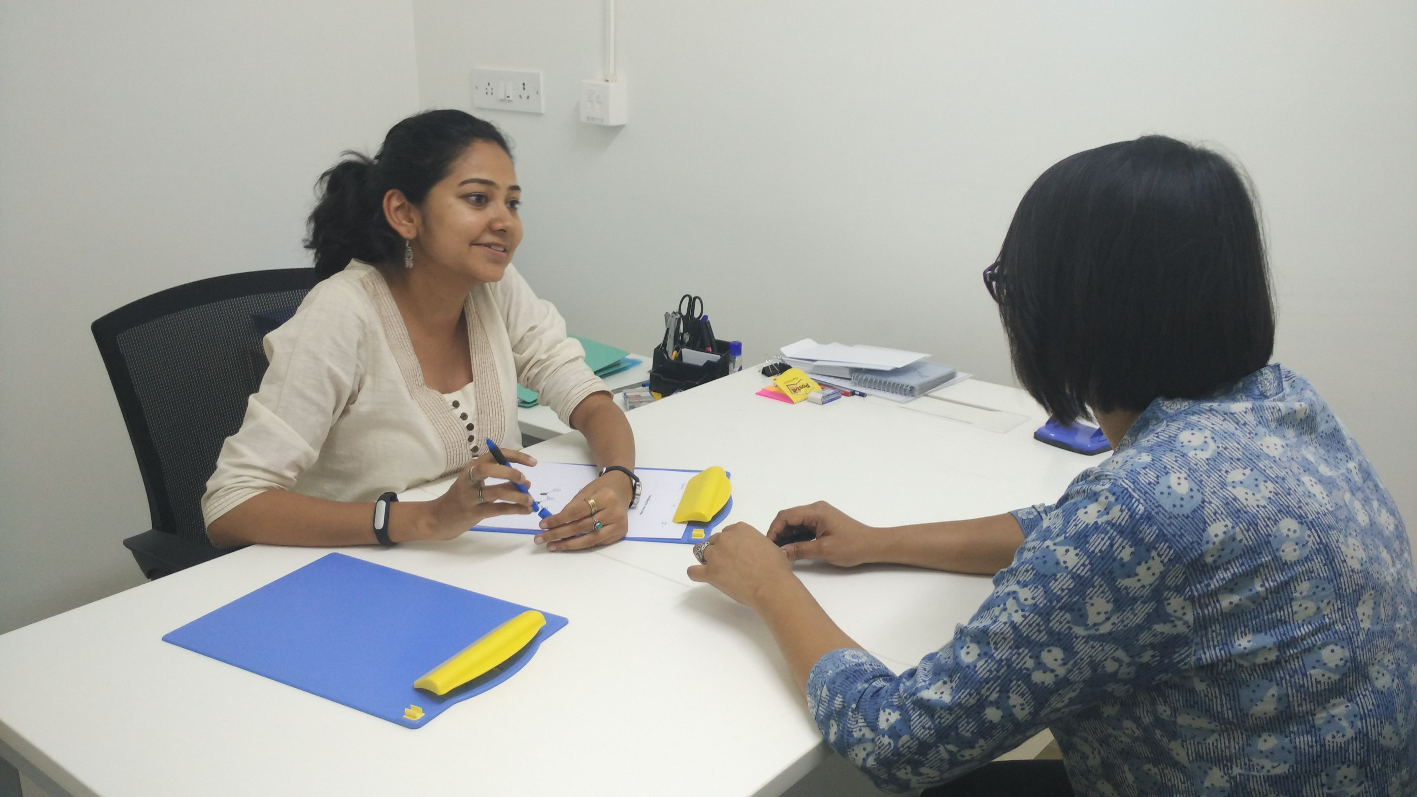
INDIA - ADNI
Dr Naren Rao
Centre for Neuroscience, Indian Institute of Science
& National Institute of Mental Health and Neurosciences
Bangalore, India

Slide 2
Tata Longitudinal study of Aging
At Centre for Neuroscience, Indian Institute of Science, Bangalore
Funded by Tata trust, a private philanthropy
2 Centres – Bangalore and Hyderabad in South India
A longitudinal study with yearly follow up
Individuals with age above 50 years are recruited from community

Slide 3
 | Baseline | Annual follow up
Clinical examination | X | X
Cognitive tests | X | X
Biochemical investigations | X | X
MRI | X | X
FDG – PET | X | X (once in 2 years)
Carotid doppler & USG abdomen | X | X
CSF collection by Lumbar puncture | X

Slide 4
Schedule of events
Assessments
Telephonic screening
Cognitive assessment
Biochemical investigation
MRI
PET
(¹⁸F-FDG)
Clinical assessment
Carotid Doppler
Ultrasound Abdomen for visceral fat

Slide 5
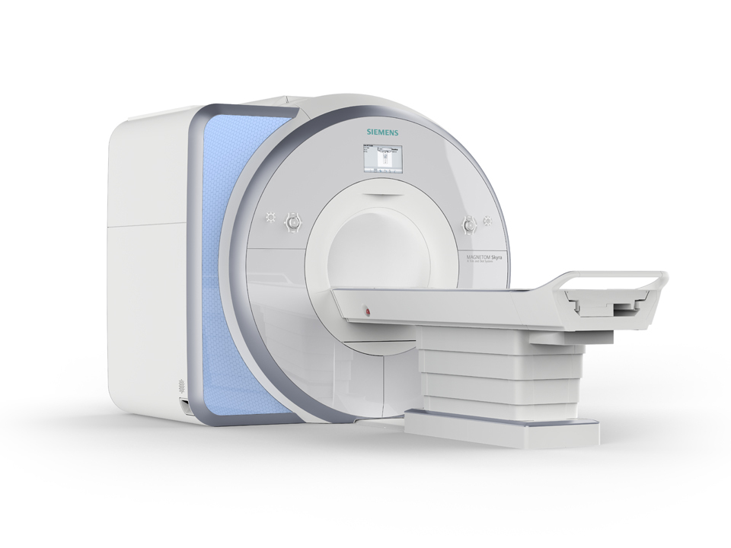
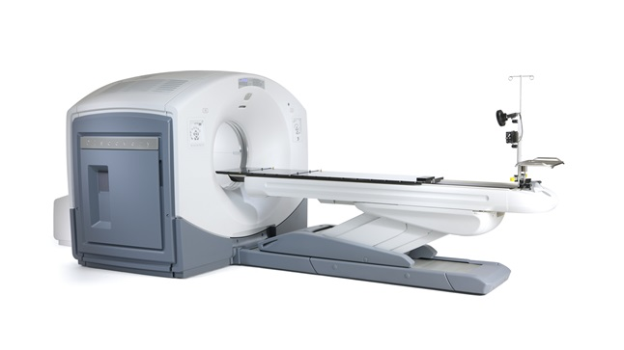
MRI
Siemens MAGNETOM Skyra 3Tesla
PET/CT
GE Discovery 690
Purchase of new research dedicated scanner – Siemens PRISMA is in process – Timeline – 6 months

Slide 6
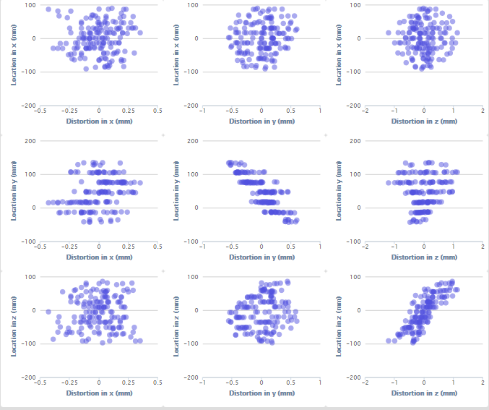
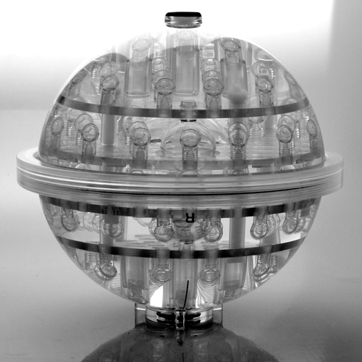
Magphan EMR051

Slide 7
INDIA – ADNI
 | Cognitive and Clinical examination | Biochemical Investigation | MRI | PET
CN | 141 (71) | 110 (66) | 109 (19) | 25 (0)
MCI | 30 (11) | 30 (7) | 29 (1) | 4 (0)
AD | 45 (30) | 40 (25) | 42 (0) | 2 (0)
Total | 206 (112) | 180 (66) | 180 (20) | 31 (0)
* - figures in parentheses indicate number of subjects who have completed year 1 follow up
Notes:
Both sites combined

Slide 8
INDIA – ADNI (Bangalore site)
HV | Cognitive and Clinical session | Clinical Investigation | MRI | PET
India study | 56 | 55 | 46 | 25
Upon ADNI age criteria | 44 | 41 | 35 | 17
F1 | 21 | 21 | 19 | 0
MCI | Cognitive and Clinical session | Clinical Investigation | MRI | PET
India study | 11 | 11 | 10 | 4
Upon ADNI age criteria | 9 | 9 | 7 | 2
F1 | 2 | 2 | 1 | -
AD | Cognitive and Clinical session | Clinical Investigation | MRI | PET
ADNI age criteria | 5 | 5 | 4 | 2

Slide 9
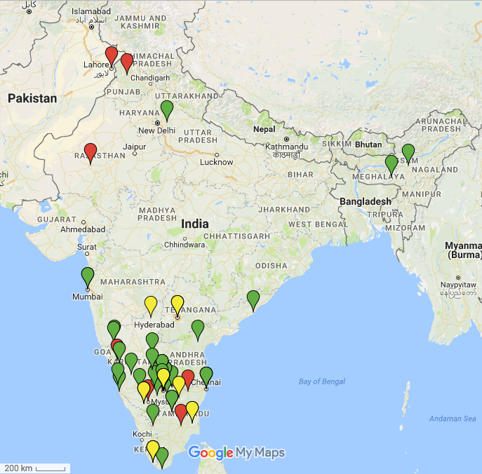
Place of birth

Slide 10
Uniqueness
Younger population (above 50 years)
Multilinguistic cohort
Illiterate population (Education level = 0)
Cognitive tests and instruments have been modified and validated
High prevalence of diabetes mellitus
Prevalence of cerebro-vascular changes : white matter hyper-intensities
Higher prevalence of vegetarian diet and Vitamin B12 deficiency
Notes:
Vitamin B12 – 15% deficient; 83% vegetarian; Diabetes – 22% of population on medication; 52% have elevated FBS > 100 - prediabetes; TSH – 33% have elevated levels; 81% - multilingual; 57% have incidental finding on MRI

Slide 11
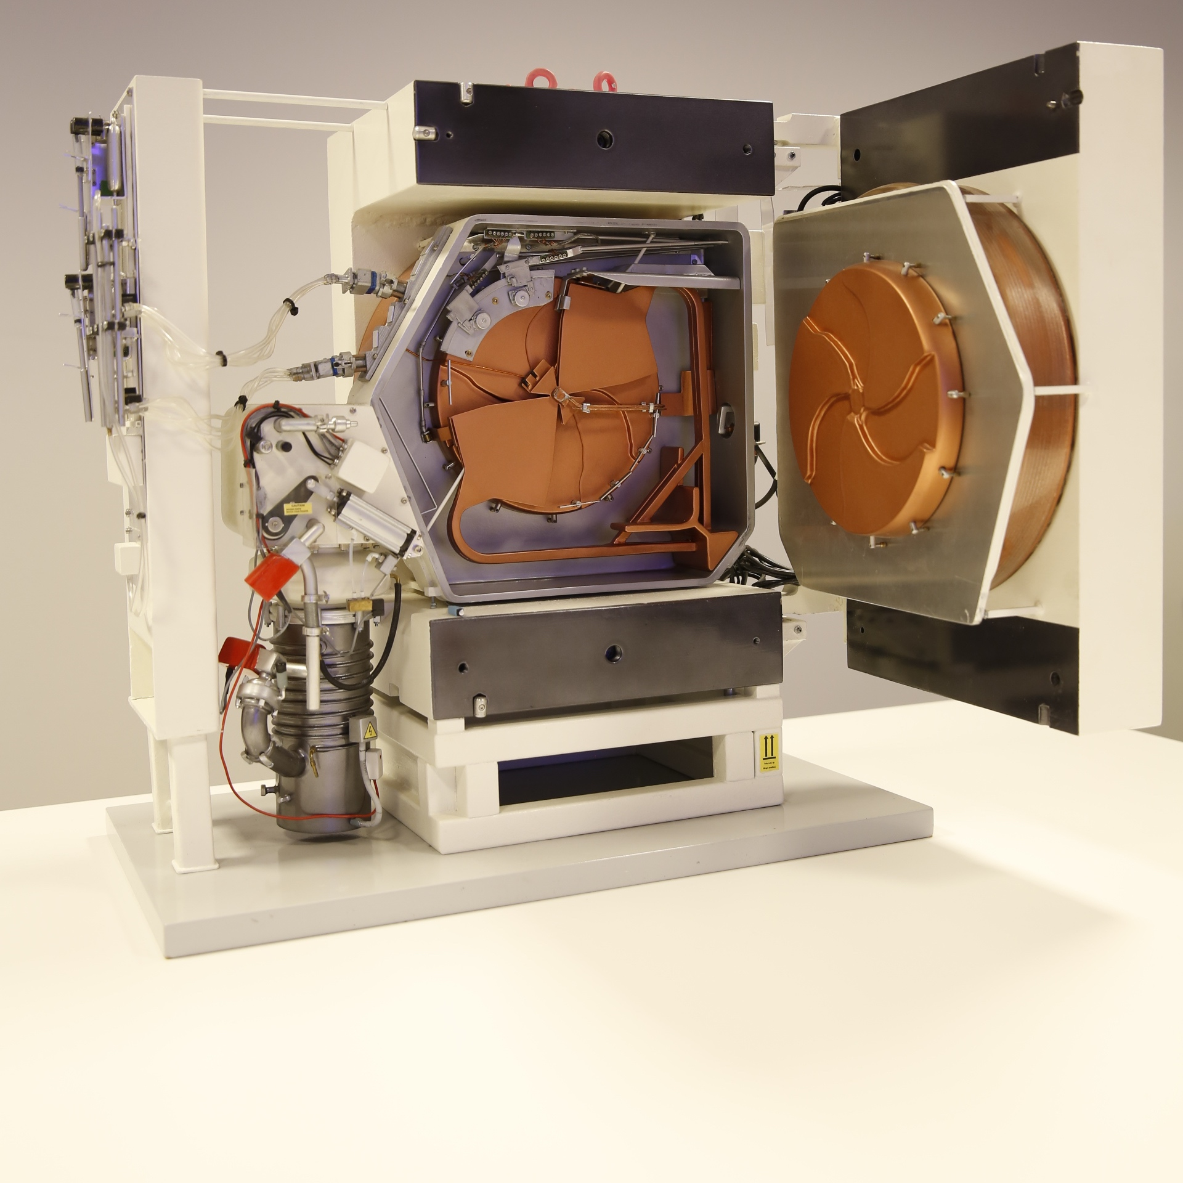
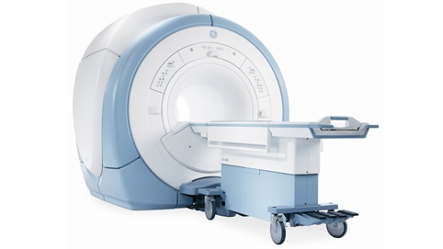
Challenges
Simultaneous PET-MRI
Technical challenge - attenuation correction and kinetic modelling in PET - MRI
Non-availability of radio-ligands for amyloid and tau PET imaging

Slide 12

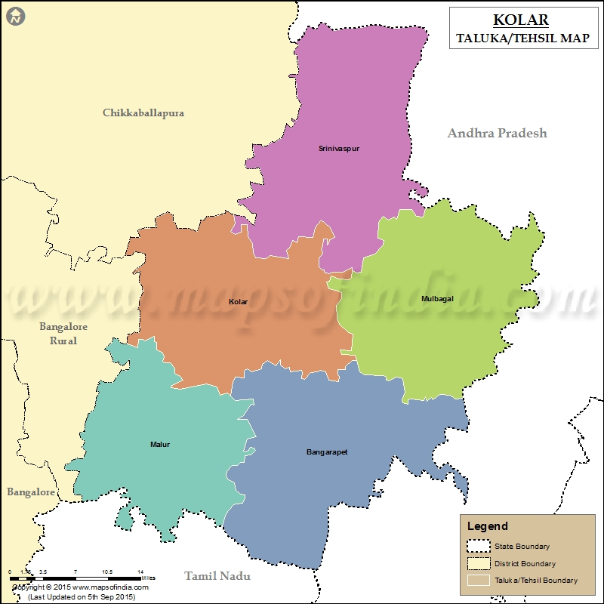


Srinivaspura Aging, Neuro Senescence and COGnition (SANSCOG)
Proposed recruitment
Pilot phase
N=30,000
N=3000
Home visit
N=10,000
N=1000
Study centre
N=1,000
N=100
PET- MRI in NIMHANS
Notes:
GC: added “to get 10,000 subjects to participate”
GC: Put genetics in 2nd visit
GC: Put ultrasound and Doppler in 3rd visit

Slide 13
Study components
Clinical assessments
Cognitive assessments
Biochemical measures
Magentic resonance imaging – Structural & functional
Positron emission tomography (PET) – tau & amyloid
Carotid Doppler, 24 hour blood pressure monitor, Echocardiography
Abdominal ultrasonography
Genetics – whole genome sequencing/ GWAS
Activity monitoring with wearable devices

Slide 14
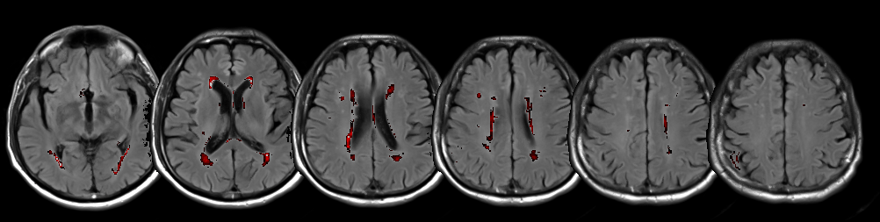
@AAIC, 2017
Relation Between Cognitive Function and White Matter Hyperintensities : Preliminary Findings from Tata Longitudinal Study of Aging
Ranjini Garani et al.
Location - S8
P3-405
Tue, Jul 18

Slide 15
@AAIC, 2017
Relationship Between Corpus Callosum Volume and Cognitive Function in Middle-Aged Adults
Simran Purokayastha et al.
Location - S8
P4-213
Wed, Jul 19

Slide 16
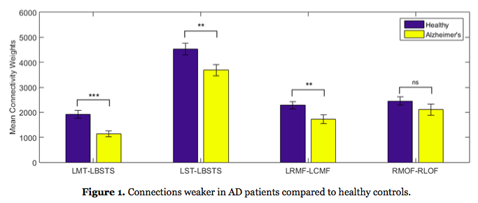
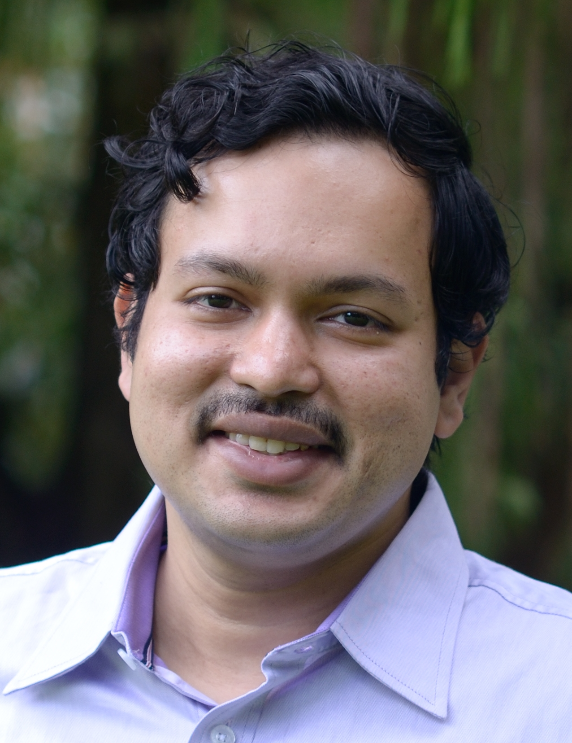
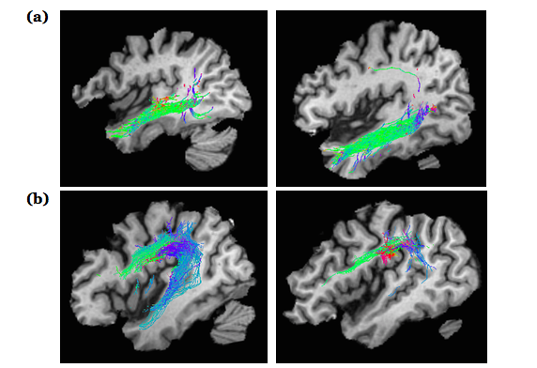
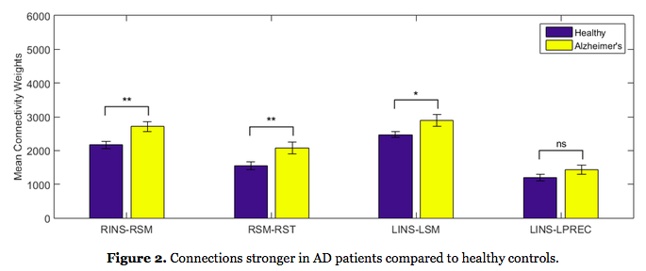
Combining diffusion MRI with a novel machine learning approach
@AAIC, 2017
AD
Healthy
Sridharan Devarajan et al
Location - S8
P4- 397
July 19th
Notes:
We performed tractography on diffusion MRI data from the ADNI database (n=98 subjects), and computed the strength of structural connections between different brain regions.
We developed a novel two-stage recursive feature elimination algorithm based on support vector machines to classify AD from healthy based on their patterns of connections
We found that AD patients had lower structural connectivity among termporal regions and among frontal regions.
Surprisingly, they showed significantly greater connectivity than normals in connections between the fronto-insular and temporal cortex.

Slide 17
THANK YOU

